Slide 1

Lecture 1: Introduction
Fei-Fei Li & Justin Johnson & Serena Yeung
1

Slide 2
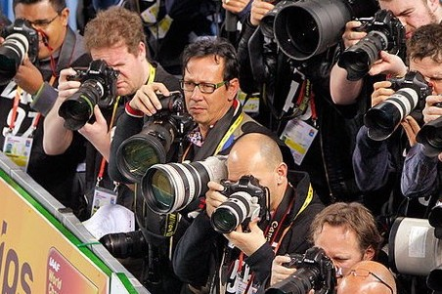
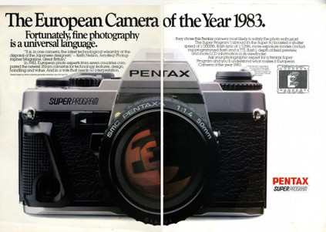
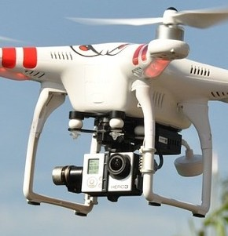
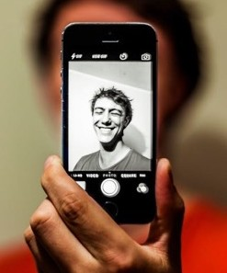
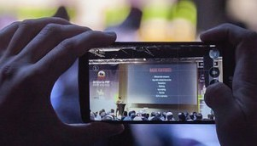
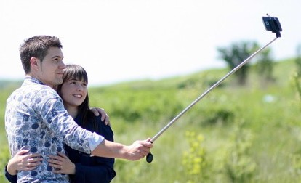
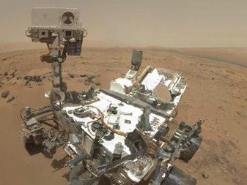
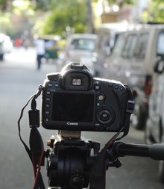
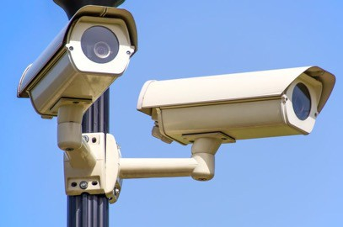
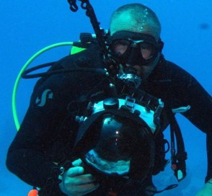
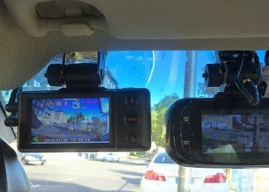
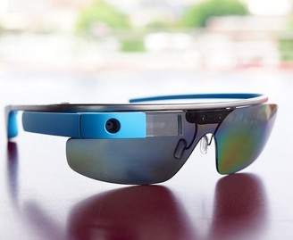
Welcome to CS231n
Top row, left to right:
Image by Augustas Didžgalvis; licensed under CC BY-SA 3.0; changes made Image by Nesster is licensed under CC BY-SA 2.0
Image is CC0 1.0 public domain Image is CC0 1.0 public domain
Middle row, left to right
Image by BGPHP Conference is licensed under CC BY 2.0; changes made Image is CC0 1.0 public domain
Image by NASA is licensed under CC BY 2.0; chang Image is CC0 1.0 public domain
Bottom row, left to right Image is CC0 1.0 public domain
Image by Derek Keats is licensed under CC BY 2.0; changes made Image is public domain
Image by Ted Eytan is licensed under CC BY-SA 2.0; changes made
Fei-Fei Li & Justin Johnson & Serena Yeung
2

Slide 3






Biology
Psychology
Neuroscience
Physics
optics
Cognitive sciences
Image processing
graphics, algorithms, theory,…
Computer Vision
Computer Science
systems, architecture, …
Speech, NLP
Robotics
Information retrieval
Engineering
Machine learning
Mathematics
Fei-Fei Li & Justin Johnson & Serena Yeung
3

Slide 4

Biology
Psychology
Neuroscience
Physics
optics
Cognitive sciences
Image processing
graphics, algorithms, theory,…
Computer Vision
Computer Science
systems, architecture, …
Speech, NLP
Robotics
Information retrieval
Engineering
Machine learning
Mathematics
Fei-Fei Li & Justin Johnson & Serena Yeung
4

Slide 5
Related Courses @ Stanford
•
CS131 (Fall 2016, Profs. Fei-Fei Li & Juan Carlos Niebles):
– Undergraduate introductory class
CS 224n (Winter 2017, Prof. Chris Manning and Richard
•
Socher)
CS231a (Spring 2017, Prof. Silvio Savarese)
Core computer vision class for seniors, masters, and PhDs
Topics include image processing, cameras, 3D reconstruction, segmentation, object recognition, scene understanding
•
CS231n (this term, Prof. Fei-Fei Li & Justin Johnson & Serena Yeung)
– Neural network (aka “deep learning”) class on image classification
And an assortment of CS331 and CS431 for advanced topics in computer vision
•
Fei-Fei Li & Justin Johnson & Serena Yeung
5

Slide 6
Today’s agenda
A brief history of computer vision
CS231n overview
Fei-Fei Li & Justin Johnson & Serena Yeung
6

Slide 7
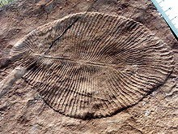
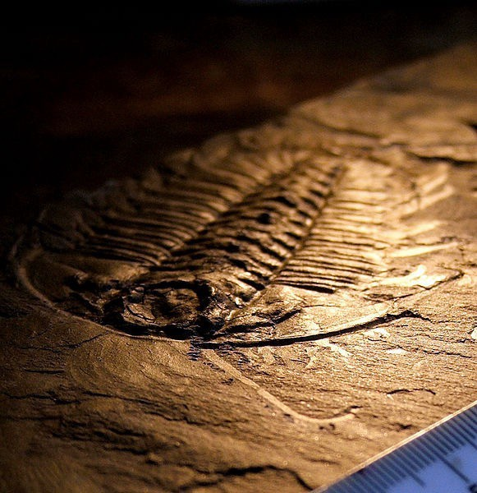
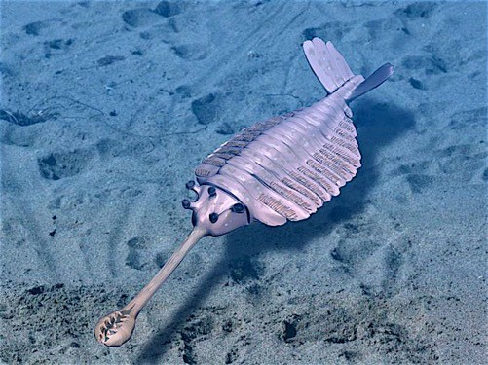
Evolution’s Big Bang
This image is licensed under CC-BY 2.5
This image is licensed under CC-BY 2.5
This image is licensed under CC-BY 3.0
543million years, B.C.
Fei-Fei Li & Justin Johnson & Serena Yeung
7

Slide 8
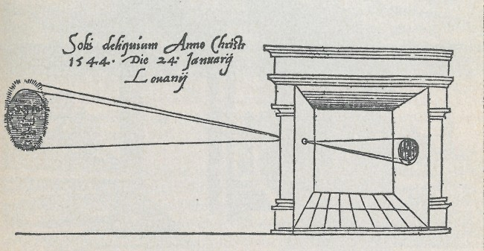
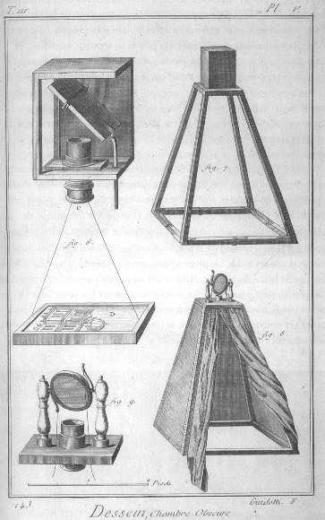
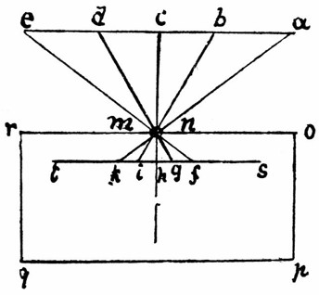
Camera Obscura
Gemma Frisius, 1545
Encyclopedie, 18th Century
This work is in the public domain
Leonardo da Vinci, 16th Century AD
This work is in the public domain
This work is in the public domain
Fei-Fei Li & Justin Johnson & Serena Yeung
8

Slide 9
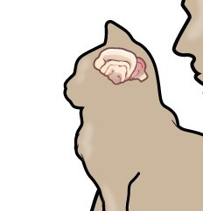
Hubel & Wiesel, 1959
Electrical signal from brain
Simple cells: Response to light orientation
Complex cells:
Response to light orientation and movement
Stimulus
Hypercomplex cells: nse to m nt with
nd
respo
oveme
an e
point
Stimulus Response
No response
Response (end point)
Cat image by CNX OpenStax is licensed under CC BY 4.0; changes made
Fei-Fei Li & Justin Johnson & Serena Yeung
9

Slide 10











Block world
Larry Roberts, 1963
(a) Original picture
(b) Differentiated picture
(c) Feature points selected
Fei-Fei Li & Justin Johnson & Serena Yeung
10

Slide 11
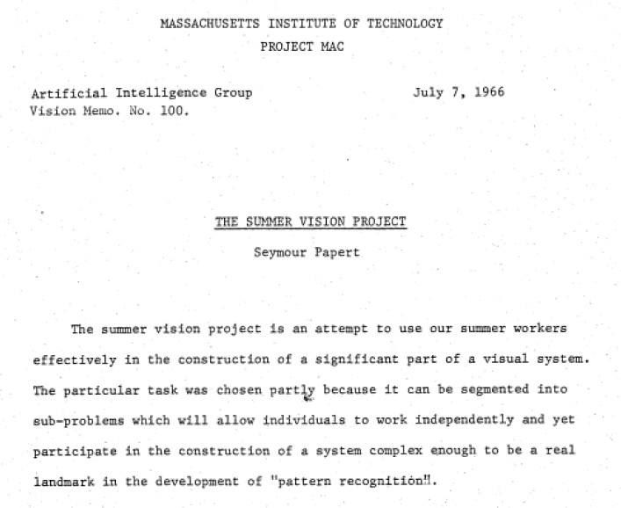
Fei-Fei Li & Justin Johnson & Serena Yeung
11

Slide 12

David Marr, 1970s
Fei-Fei Li & Justin Johnson & Serena Yeung
12

Slide 13
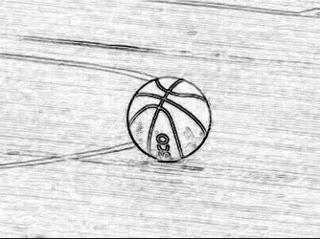

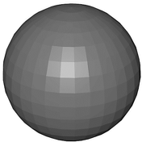

2 ½-D sketch
3-D model
Input image
Edge image
This image is CC0 1.0 public domain
This image is CC0 1.0 public domain
Input Image
Perceived intensities
Primal Sketch
Zero crossings, blobs, edges, bars, ends, virtual lines, groups, curves boundaries
2 ½-D Sketch
Local surface orientation and discontinuities in depth and in surface orientation
3-D Model Representation
3-D models hierarchically organized in terms of surface and volumetric primitives
Stages of Visual Representation, David Marr, 1970s
Fei-Fei Li & Justin Johnson & Serena Yeung
13

Slide 14











Generalized Cylinder
Pictorial Structure
Fischler and Elschlager, 1973
•
•
Brooks & Binford, 1979
Fei-Fei Li & Justin Johnson & Serena Yeung
14

Slide 15
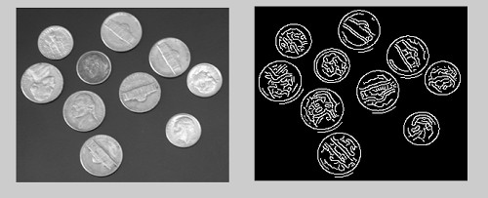
Image is CC BY-SA 4.0
David Lowe, 1987
Fei-Fei Li & Justin Johnson & Serena Yeung
15

Slide 16

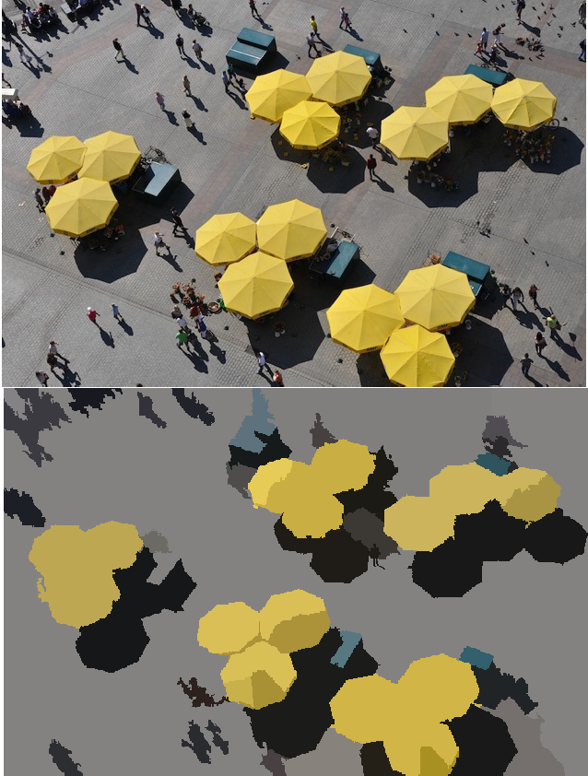
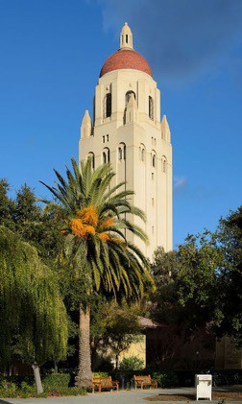

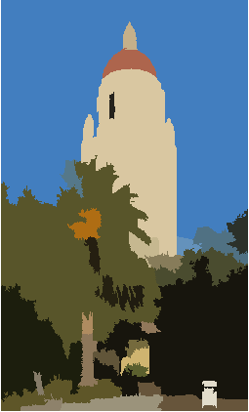
Normalized Cut (Shi & Malik, 1997)
Image is CC BY 3.0
Image is public domain
Image is CC-BY SA 3.0
Fei-Fei Li & Justin Johnson & Serena Yeung
16

Slide 17
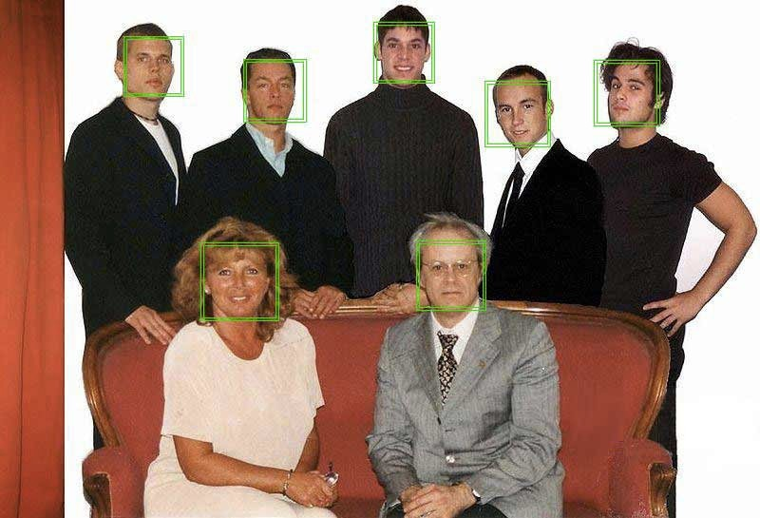




Face Detection, Viola & Jones, 2001
Image is public domain
Fei-Fei Li & Justin Johnson & Serena Yeung
17

Slide 18
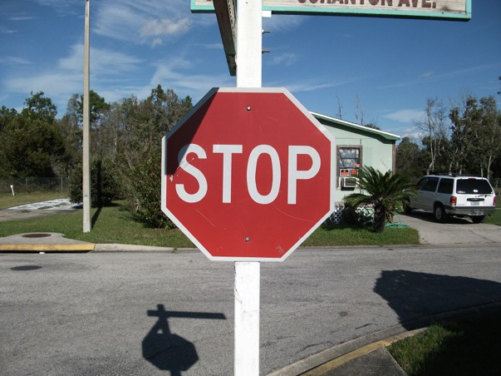





Image is public domain
Image is CC BY-SA 2.0
“SIFT” & Object Recognition, David Lowe, 1999
Fei-Fei Li & Justin Johnson & Serena Yeung
18

Slide 19









Image is CC0 1.0 public domain
Level 0 Level 1
Spatial Pyramid Matching, Lazebnik, Schmid & Ponce, 2006
Fei-Fei Li & Justin Johnson & Serena Yeung
19

Slide 20






















Image is CC0 1.0 public domain
Deformable Part Model Felzenswalb, McAllester, Ramanan, 2009
orientation
Histogram of Gradients (HoG) Dalal & Triggs, 2005
Fei-Fei Li & Justin Johnson & Serena Yeung
20

Slide 21
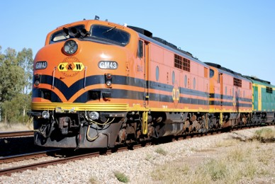
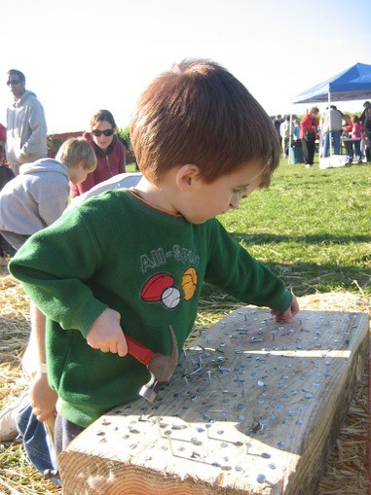

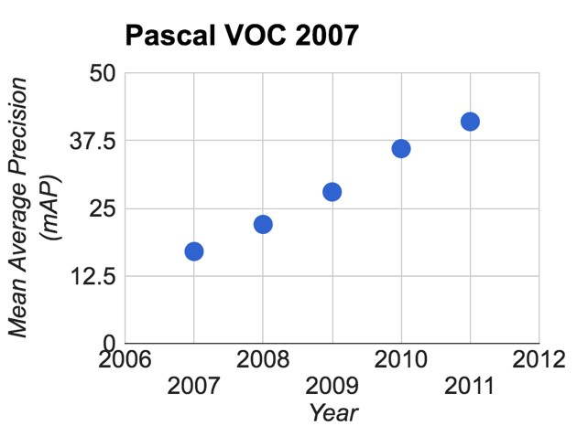

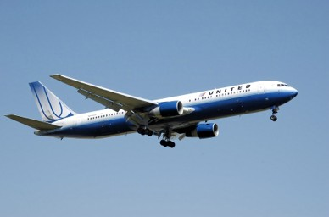

PASCAL Visual Object Challenge (20 object categories)
[Everingham et al. 2006-2012]
Image is CC BY-SA 3.0
Train
Person
Airplane
Image is CC0 1.0 public domain
This image is licensed under CC BY-SA 2.0; changes made
Fei-Fei Li & Justin Johnson & Serena Yeung
21

Slide 22
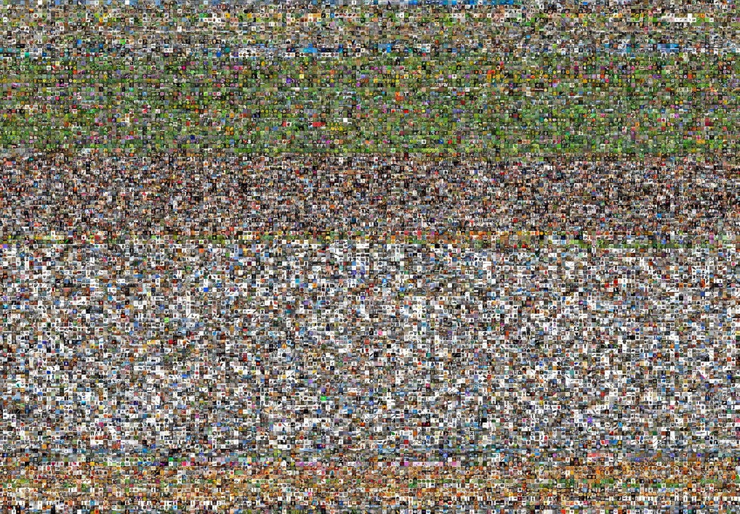


www.image-net.org
22K categories and 14M images
Animals
Bird
Fish
Mammal •
Invertebrate •
Plants •
Tree •
Flower Food Materials
Structures Artifact
Tools
Appliances
Structures
•
•
Person Scenes
Indoor
Geological Formations Sport Activities
•
Deng, Dong, Socher, Li, Li, & Fei-Fei, 2009
Fei-Fei Li & Justin Johnson & Serena Yeung
22

Slide 23
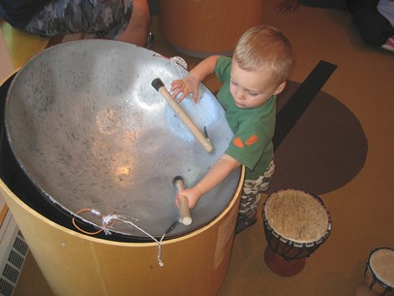
Steel drum
The Image Classification Challenge:
1,000 object classes
1,431,167 images
Output:
Scale T-shirt
Steel drum Drumstick Mud turtle
Output:
Scale T-shirt
Giant panda Drumstick Mud turtle
✔
✗
Russakovsky et al. arXiv, 2014
Fei-Fei Li & Justin Johnson & Serena Yeung
23

Slide 24
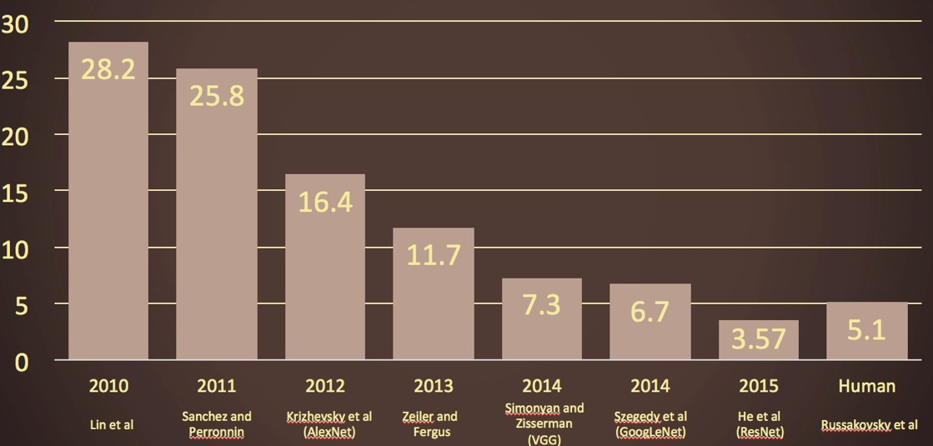
The Image Classification Challenge: 1,000 object classes
S
teel drum
1,431,167 images
Russakovsky et al. arXiv, 2014
Fei-Fei Li & Justin Johnson & Serena Yeung
24

Slide 25
Today’s agenda
A brief history of computer vision
CS231n overview
Fei-Fei Li & Justin Johnson & Serena Yeung
25

Slide 26
CS231n focuses on one of the most important problems of visual recognition –
image classification
Fei-Fei Li & Justin Johnson & Serena Yeung
26

Slide 27
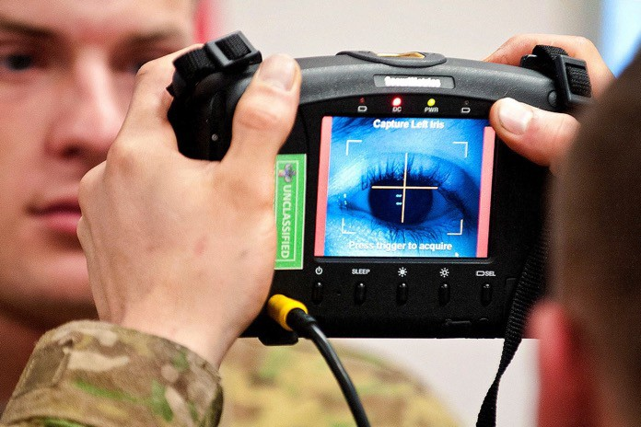
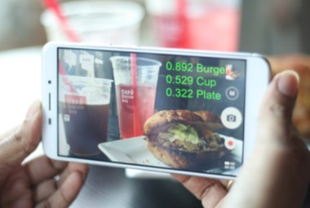
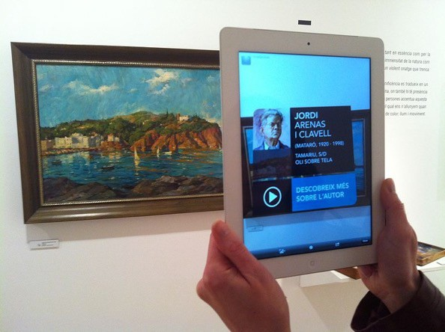
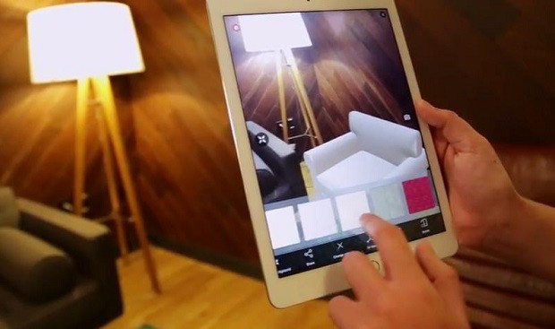
Image by US Army is licensed under CC BY 2.0
Image is CC0 1.0 public domain
Image by Kippelboy is licensed under CC BY-SA 3.0
Image by Christina C. is licensed under CC BY-SA 4.0
Fei-Fei Li & Justin Johnson & Serena Yeung
27

Slide 28
There is a number of visual recognition problems that are related to image classification, such as object detection, image captioning
Fei-Fei Li & Justin Johnson & Serena Yeung
28

Slide 29
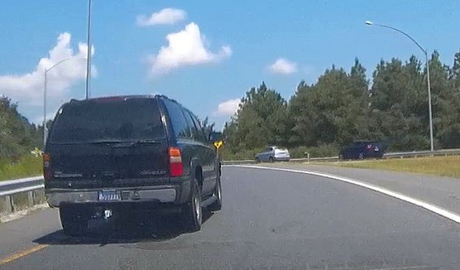
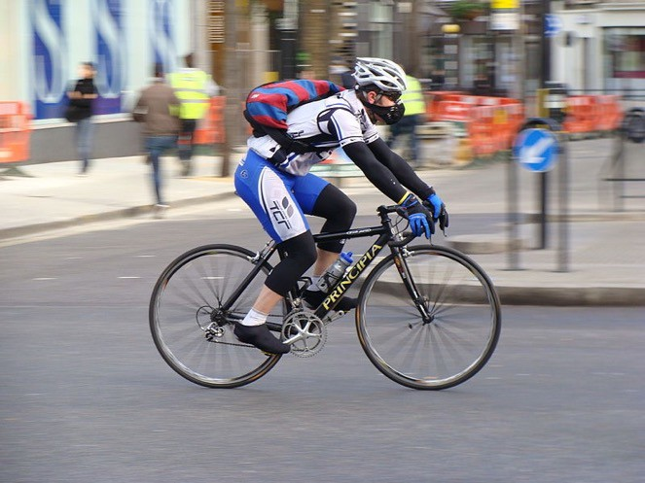

Object detection
Action classification
Image captioning
…
This image is licensed under CC BY-NC-SA 2.0; changes made
Person on Bike
Person
Hammer
Person
Bike
This image is licensed under CC BY-SA 2.0; changes made
This image is licensed under CC BY-SA 3.0; changes made
Fei-Fei Li & Justin Johnson & Serena Yeung
29

Slide 30
Convolutional Neural Networks (CNN) have become an important tool for object recognition
Fei-Fei Li & Justin Johnson & Serena Yeung
30

Slide 31
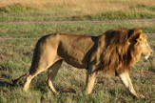
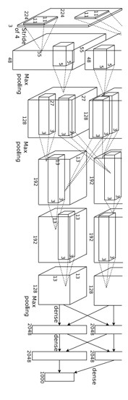



Year 2010
Year 2012
SuperVision
Year 2014
GoogLeNet
Pooling Convolution Softmax Other
Year 2015
MSRA
NEC-UIUC
VGG
Image
conv-64
conv-64
maxpool
Dense descriptor grid: HOG, LBP
conv-128
conv-128
maxpool
Coding: local coordinate, super-vector
conv-256
conv-256
maxpool
conv-512
conv-512
maxpool
Pooling, SPM
conv-512
conv-512
maxpool
Linear SVM
fc-4096
fc-4096
fc-1000
softmax
[Lin CVPR 2011]
[Krizhevsky NIPS 2012]
Figure copyright Alex Krizhevsky, Ilya Sutskever, and Geoffrey Hinton, 2012. Reproduced with permission.
Lion image by Swissfrog is licensed under CC BY 3.0
[Szegedy arxiv 2014]
[Simonyan arxiv 2014]
[He ICCV 2015]
Fei-Fei Li & Justin Johnson & Serena Yeung
31

Slide 32
Convolutional Neural Networks (CNN) were not invented overnight
Fei-Fei Li & Justin Johnson & Serena Yeung
32

Slide 33


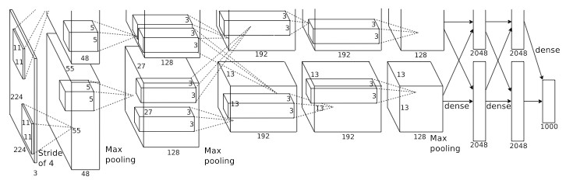

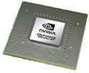

Image Maps
1998
Input
K
LeCun et al.
Output
Convolutions
Fully Connected
Subsampling
# of transistors
10⁶
# of pixels used in training
10⁷
2012
Krizhevsky et al.
# of transistors
10⁹
GPUs
# of pixels used in training
₁₀14
Figure copyright Alex Krizhevsky, Ilya Sutskever, and Geoffrey Hinton, 2012. Reproduced with permission.
Fei-Fei Li & Justin Johnson & Serena Yeung
33

Slide 34
The quest for visual intelligence goes far beyond object recognition…
Fei-Fei Li & Justin Johnson & Serena Yeung
34

Slide 35

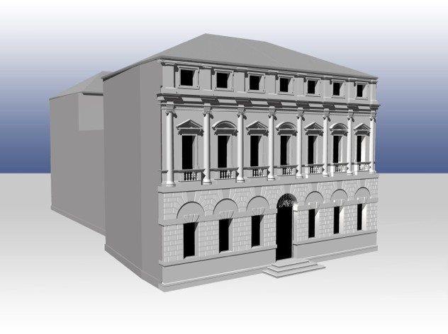
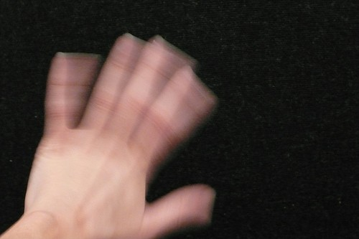
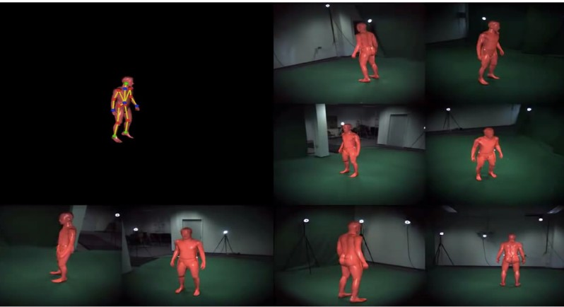

Wall
Image is CC0 1.0 public domain
Laptop
Glass
Wire
Desk
Image is GFDL
Image is CC BY-SA 2.0
Image is CC BY-SA 4.0
Waving
Fei-Fei Li & Justin Johnson & Serena Yeung
35

Slide 36
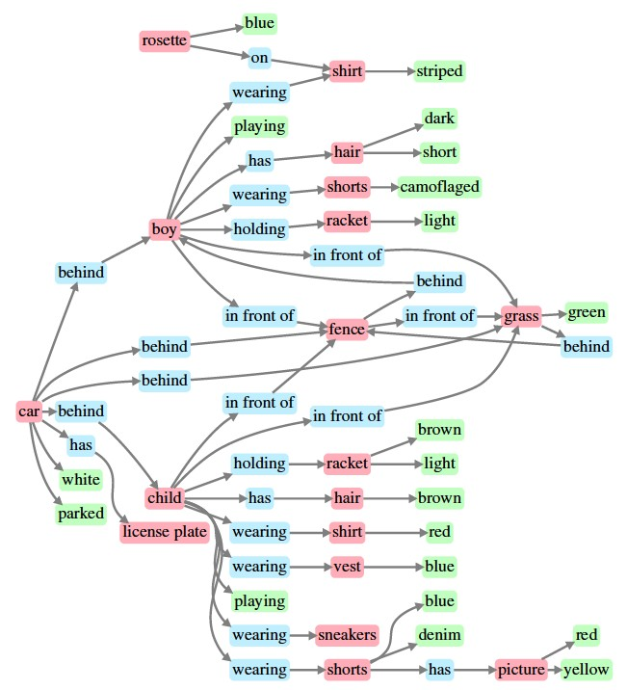
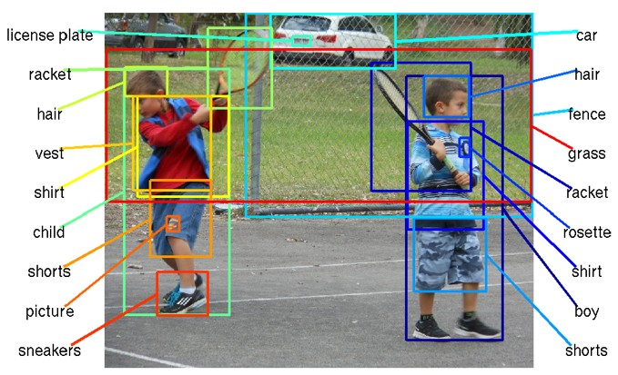
Johnson et al., “Image Retrieval using Scene Graphs”, CVPR 2015
Figures copyright IEEE, 2015. Reproduced for educational purposes
Fei-Fei Li & Justin Johnson & Serena Yeung
36

Slide 37

PT = 500ms
Some kind of game or fight. Two groups of two men? The man on the left is throwing something. Outdoors seemed like because i have an impression of grass and maybe lines on the grass? That would be why I think perhaps a game, rough game though, more like rugby than football because they pairs weren't in pads and helmets, though I did get the impression of similar clothing. maybe some trees? in the background. (Subject: SM)
Fei-Fei, Iyer, Koch, Perona, JoV, 2007
Image is licensed under CC BY-SA 3.0; changes made
Fei-Fei Li & Justin Johnson & Serena Yeung
37

Slide 38

This image is copyright-free United States government work
Example credit: Andrej Karpathy
Fei-Fei Li & Justin Johnson & Serena Yeung
38

Slide 39










Computer Vision Technology Can Better Our Lives
Outside border images, clockwise, starting from top left:
Image by Pop Culture Geek is licensed under CC BY 2.0; changes made Image by the US Government is in the public domain
Image by the US Government is in the public domain
Image by Glogger is licensed under CC BY-SA 3.0; changes made Image by Sylenius is licensed under CC BY 3.0; changes made Image by US Government is in the public domain
Inside four images, clockwise, starting from top left:
Image is CC0 1.0 public domain Image by Tucania is licensed under CC BY-SA 3.0; changes made
Image by Intuitive Surgical, Inc. is licensed under CC BY-SA 3.0; changes made Image by Oyundari Zorigtbaatar is licensed under CC BY-SA 4.0
Fei-Fei Li & Justin Johnson & Serena Yeung
39

Slide 40





Who we are
Instructors
Emeritus
Teaching Assistants
Fei-Fei Li & Justin Johnson & Serena Yeung
40

Slide 41

Course Logistics
Keeping in touch:
Piazza
cs231n-spring1617-staff@lists.stanford.edu
Optional textbook:
Deep Learning by Goodfellow, Bengio, and Courville
Free online
Fei-Fei Li & Justin Johnson & Serena Yeung
41

Slide 42
Our philosophy
Thorough and Detailed.
– Understand how to write from scratch, debug and train convolutional neural networks.
Practical.
– Focus on practical techniques for training these networks at scale, and on GPUs (e.g. will touch on distributed optimization, differences between CPU vs. GPU, etc.) Also look at state of the art software tools such as Caffe, TensorFlow, and (Py)Torch
State of the art.
Most materials are new from research world in the past 1-3 years. Very exciting stuff!
Fun.
Some fun topics such as Image Captioning (using RNN)
Also DeepDream, NeuralStyle, etc.
•
Fei-Fei Li & Justin Johnson & Serena Yeung
42

Slide 43





Our philosophy (cont’d)
Fun.
Some fun topics such as Image Captioning (using RNN)
Also DeepDream, NeuralStyle, etc.
•
Fei-Fei Li & Justin Johnson & Serena Yeung
43

Slide 44
Grading policy
•
•
•
3 Problem Sets: 15% x 3 = 45%
Midterm Exam: 15% Final Course Project: 40%
Milestone: 5%
Final write-up: 35%
Bonus points for exceptional poster presentation
Late policy
7 free late days – use them in your ways
Afterwards, 25% off per day late
Not accepted after 3 late days per PS
Does not apply to Final Course Project
Collaboration policy
Read the student code book, understand what is ‘collaboration’ and what is ‘academic infraction’
•
•
Fei-Fei Li & Justin Johnson & Serena Yeung
44

Slide 45
Pre-requisite
Proficiency in Python, some high-level familiarity with C/C++
All class assignments will be in Python (and use numpy), but some of the deep learning libraries we may look at later in the class are written in C++.
A Python tutorial available on course website
College Calculus, Linear Algebra
Equivalent knowledge of CS229 (Machine Learning)
We will be formulating cost functions, taking derivatives and performing optimization with gradient descent.
Fei-Fei Li & Justin Johnson & Serena Yeung
45

Slide 46
Syllabus
Go to website…
http://cs231n.stanford.edu/
Fei-Fei Li & Justin Johnson & Serena Yeung
46

Slide 47
References
•
Hubel, David H., and Torsten N. Wiesel. "Receptive fields, binocular interaction and functional architecture in the cat's visual cortex." The Journal of physiology 160.1 (1962): 106. [PDF]
Roberts, Lawrence Gilman. "Machine Perception of Three-dimensional Solids." Diss. Massachusetts Institute of Technology, 1963. [PDF]
Marr, David. "Vision.” The MIT Press, 1982. [PDF]
Brooks, Rodney A., and Creiner, Russell and Binford, Thomas O. "The ACRONYM model-based vision system. " In Proceedings of the 6th International Joint Conference on Artificial Intelligence (1979): 105-113. [PDF]
Fischler, Martin A., and Robert A. Elschlager. "The representation and matching of pictorial structures." IEEE Transactions on Computers 22.1 (1973): 67-92. [PDF]
Lowe, David G., "Three-dimensional object recognition from single two-dimensional images," Artificial Intelligence, 31, 3 (1987), pp. 355-395. [PDF]
Shi, Jianbo, and Jitendra Malik. "Normalized cuts and image segmentation." Pattern Analysis and Machine Intelligence, IEEE Transactions on 22.8 (2000): 888-905. [PDF]
Viola, Paul, and Michael Jones. "Rapid object detection using a boosted cascade of simple features." Computer Vision and Pattern Recognition, 2001. CVPR 2001. Proceedings of the 2001 IEEE Computer Society Conference on. Vol. 1. IEEE, 2001. [PDF]
Lowe, David G. "Distinctive image features from scale-invariant keypoints." International Journal of Computer Vision 60.2 (2004): 91-110. [PDF]
Lazebnik, Svetlana, Cordelia Schmid, and Jean Ponce. "Beyond bags of features: Spatial pyramid matching for recognizing natural scene categories." Computer Vision and Pattern Recognition, 2006 IEEE Computer Society Conference on. Vol. 2. IEEE, 2006. [PDF]
•
•
•
•
•
•
•
•
•
Fei-Fei Li & Justin Johnson & Serena Yeung
47

Slide 48
•
Dalal, Navneet, and Bill Triggs. "Histograms of oriented gradients for human detection." Computer Vision and Pattern Recognition, 2005. CVPR 2005. IEEE Computer Society Conference on. Vol. 1. IEEE, 2005. [PDF]
Felzenszwalb, Pedro, David McAllester, and Deva Ramanan. "A discriminatively trained, multiscale, deformable part model." Computer Vision and Pattern Recognition, 2008. CVPR 2008. IEEE Conference on. IEEE, 2008 [PDF]
Everingham, Mark, et al. "The pascal visual object classes (VOC) challenge." International Journal of Computer Vision 88.2 (2010): 303-338. [PDF]
Deng, Jia, et al. "Imagenet: A large-scale hierarchical image database." Computer Vision and Pattern Recognition, 2009. CVPR 2009. IEEE Conference on. IEEE, 2009. [PDF]
Russakovsky, Olga, et al. "Imagenet Large Scale Visual Recognition Challenge." arXiv:1409.0575. [PDF] Lin, Yuanqing, et al. "Large-scale image classification: fast feature extraction and SVM training." Computer Vision and Pattern Recognition (CVPR), 2011 IEEE Conference on. IEEE, 2011. [PDF] Krizhevsky, Alex, Ilya Sutskever, and Geoffrey E. Hinton. "Imagenet classification with deep convolutional neural networks." Advances in neural information processing systems. 2012. [PDF]
Szegedy, Christian, et al. "Going deeper with convolutions." arXiv preprint arXiv:1409.4842 (2014). [PDF] Simonyan, Karen, and Andrew Zisserman. "Very deep convolutional networks for large-scale image recognition." arXiv preprint arXiv:1409.1556 (2014). [PDF]
He, Kaiming, et al. "Spatial Pyramid Pooling in Deep Convolutional Networks for Visual Recognition." arXiv preprint arXiv:1406.4729 (2014). [PDF]
LeCun, Yann, et al. "Gradient-based learning applied to document recognition." Proceedings of the IEEE 86.11 (1998): 2278-2324. [PDF]
Fei-Fei, Li, et al. "What do we perceive in a glance of a real-world scene?." Journal of vision 7.1 (2007):
•
•
•
•
•
•
•
•
•
•
•
10. [PDF]
Fei-Fei Li & Justin Johnson & Serena Yeung
48

